Slide 1
Module:1 Algorithm Analysis
A.VIJAYALAKSHMI
Associate Professor
School of Computer Science and Engineering
Chennai

Slide 2
Contact No : 9445958156
Email ID : vijayalakshmi.av@vit.ac.in
Place to meet : AB1 - 3rd Floor Annexure

Slide 3
Text Books
Mark A. Weiss, Data Structures & Algorithm Analysis in C++, 4th Edition, 2013, Pearson Education.
Alfred V. Aho, Jeffrey D. Ullman and John E. Hopcroft, Data Structures and Algorithms, 1983, Pearson Education.
Thomas H. Cormen, C.E. Leiserson, R L.Rivest and C. Stein, Introduction to Algorithms , Paper Back 2010, Third edition, MIT Press, 2010

Slide 4
Data Structures
Way of organizing data’s in memory.
Relationship among the data items in the memory.
It is a particular way of storing and organizing data in a computer memory so that it can be used efficiently.

Slide 5
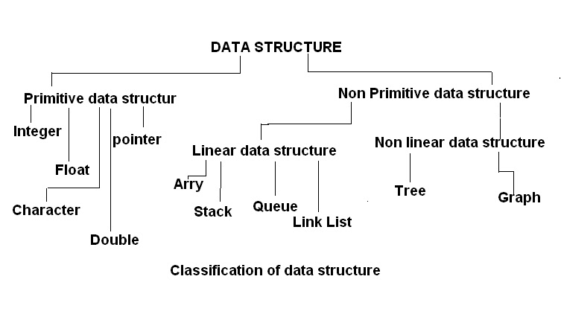
Classification of Data Structures

Slide 6
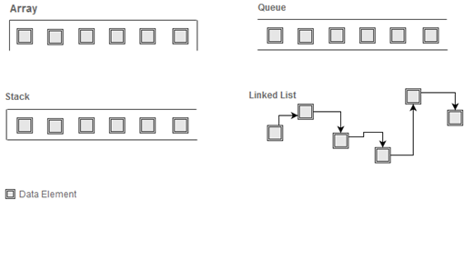
Linear Data Structures

Slide 7
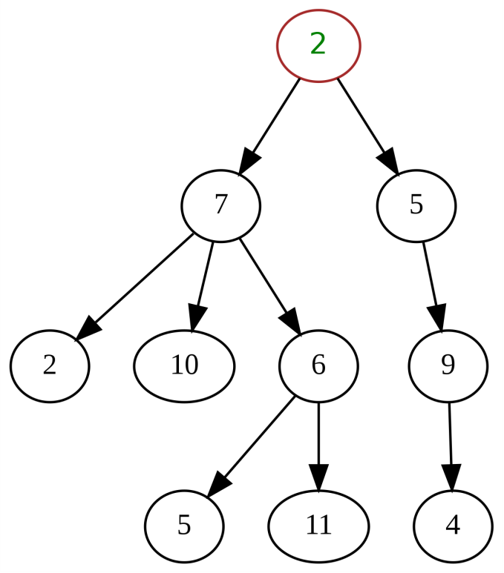

Non-Linear Data Structures
Tree Data Structure
Graph Data Structure

Slide 8
Terminology
Abstract Data Type (ADT)
Mathematical description of an object with set of operations on the object. Useful building block.
Algorithm
A high level, language independent, description of a step-by-step process
Data structure
A specific family of algorithms for implementing an abstract data type.
Implementation of data structure
A specific implementation in a specific language

Slide 9
Terminology examples
A stack is an abstract data type supporting push, pop and isEmpty operations
A stack data structure could use an array, a linked list, or anything that can hold data
One stack implementation is java.util.Stack; another is java.util.LinkedList

Slide 10
Algorithm
An algorithm (pronounced AL-go-rith-um) is a step-by-step procedure or formula for solving a problem.
The word derives from the name of the mathematician, Mohammed ibn-Musa al-Khwarizmi.
An algorithm is independent of programming language.
A computer program can be viewed as an elaborate algorithm. In mathematics and computer science, an algorithm usually means a small procedure that solves a recurrent problem.

Slide 11

Problem Solving
Person A
Person B
------------------------
------------------------
------------------------
…
…
…
…
…
------------------------
------------------------
------------------------
------------------------
------------------------
------------------------
…
…
…
…
…
------------------------
------------------------
------------------------
50 instructions
100 instructions

Slide 12

Problem Solving
L1
L2
L3
Problem
.
.
Ln-1
Ln

Slide 13
Problem Solving
A Problem may have many solutions.
Selecting an appropriate solution among the possible solutions.
Analyzing the efficiency among the solutions to select an efficient and optimal solution
Factors to be considered for efficiency – Time and space factors.

Slide 14
Algorithm Analysis

Slide 15
Algorithm Analysis
Efficiency is inversely proportional to T(p) and S(p)
T(p) = C.T + R.T
S(p) = Data space+ Instruction space + Env.Stack
Time Complexity T(P): Indicates how fast an algorithm runs. The amount of time required to completely execute the algorithm.
Space Complexity S(P): The amount of memory space required for the algorithm.
Instruction space, data space and Environmental stack

Slide 16
Algorithm Analysis
Instruction space – The amount of space used to save the compiled version of the instruction.
Environmental stack – Sometimes an algorithm may be called inside another algorithm. In such a situation, the current variables are pushed onto the system stack, where they wait for further execution and then the call to the inside algorithm is made.
Data space – Amount of space used by the variable and constants.
But while calculating space complexity only data space is considered and we neglect the instruction space and Environment stack.

Slide 17
Algorithm Analysis
Predicting the resources that the algorithm requires.
Memory, Communication band-width, or Computer hardware, computational time
Analyzing several candidate algorithms for a problem

Slide 18
Time complexity of the program – amount of computer time needs to run a program.
Space complexity of a program is the amount of memory needed to run a program.

Slide 19
Space Complexity
Instruction space – space required to store the machine code generated by the compiler.
Data space – space needed for constants, variables, intermediate variables, dynamic variables etc.,
Stack space- to store return address, return values etc.,

Slide 20
Instruction space
It depends on the compiler.
Compilers also use code optimization techniques to produce efficient code.
Most compilers use dynamic linking and loading concepts, where we get memory for largest module rather than sum of all the modules.
Instruction space is constant throughout the execution of the program.

Slide 21
Data space
Space occupied by constants, program, simple variables, arrays, structures, pointers etc.,
Ex: int i;
float f;

Slide 22
Run Time
Run time depends on following factors:
Type of processor used (Single or Multiprocessor).
I/O speed to memory.
Architecture we use (32bit or 64 bit).
Input size. (Rate of growth of time w.r.t Input).

Slide 23
Analysis of algorithms
Primitive operations: Low level operation independent of programming language.
Data Movement (assign)
Control (branch, subroutine call, return)
Arithmetic and logical operations (e.g. addition, comparison)
By inspecting the pseudo code we can count the number of primitive operations executed by an algorithm

Slide 24
Example for Iterative Algorithm
Calculate the factorial of a number
find_factorial(n)
1. factorial ← 1
2. for i ← 2 to n step up by 1
3. factorial ← factorial * i
4. end for
5. end find_factorial
1
n
N-1
1
1

Slide 25
Time complexity
The running time of an algorithm on a particular input is the number of primitive operations or steps executed.
There are several methods to find the running time of a program.
Operation counts
Step counts
Asymptotic notations
Practical method

Slide 26
There are two basic phases in the process of executing a program.
The first phase is the compilation of the program.
Compile time depends on particular compiler and it does not depends upon the input size.
Second phase is the run time which depends on the input size of n. i.e T(n).

Slide 27
Analysis of algorithms
Generally, we perform the following types of analysis −
Worst-case − The maximum number of steps taken on any instance of size a.
Best-case − The minimum number of steps taken on any instance of size a.
Average case − An average number of steps taken on any instance of size a.
Amortized − A sequence of operations applied to the input of size a averaged over time.

Slide 28
The Execution Time of Algorithms
Each operation in an algorithm (or a program) has a cost.
Each operation takes a certain amount of time.
count = count + 1; // take a certain amount of time, but it is constant
A sequence of operations:
count = count + 1; 1 Cost: c₁
sum = sum + count; 1 Cost: c₂
Total Cost = c₁ + c₂

Slide 29
Swapping
Read a,b - 1
t=a - 1
a=b - 1
b=t - 1
Print a,b - 1
Total Cost = O(c), c=5 (Constant)

Slide 30
The Execution Time of Algorithms (cont.)
Example: Simple If-Statement
Cost Times
if (n < 0) c1 1
absval = -n c2 1
else
absval = n; c3 1
Total Cost <= c1 + max(c2,c3)

Slide 31
The Execution Time of Algorithms (cont.)
Example: Simple Loop
Cost Times
i = 1; c1 1
sum = 0; c2 1
while (i <= n) { c3 n+1
sum = sum + i; c4 n
i = i + 1; c5 n
}
Total Cost = 1+1+n+1+n+n = 3+3n = 3n = O(n) = Linear Run time
➔ The time required for this algorithm is proportional to n

Slide 32
The Execution Time of Algorithms (cont.)
Example: Simple Loop
Cost Times
i = 1; 1 1
until(i <= 3) 3+1 n+1
{
print i; 3 n
i = i + 1; 3 n
}
Total Cost = 1+(n+1)+n+n = 2+3n = 3n = O(n) = Linear Run time
➔ The time required for this algorithm is proportional to n

Slide 33
Example for Iterative Algorithm
Calculate the factorial of a number
find_factorial(n)
1. factorial ← 1
2. for i ← 2 to n step up by 1
3. factorial ← factorial * i
4. end for
5. end find_factorial
1
n
N-1
1
1

Slide 34
The Execution Time of Algorithms (cont.)
i=0 1 1
j=0 1 1
Until(i<3) 3+1 n+1
until(j<3) 3(3+1) n(n+1)
print(j)
Cost = 1+1+n+1+n(n+1)
= 3+n+n²+n = 3+2n+n²
= n²
= O(n²)

Slide 35
The Execution Time of Algorithms (cont.)
Example: Nested Loop
Cost Times
i=1; c1 1
sum = 0; c2 1
while (i <= n) { c3 n+1
j=1; c4 n
while (j <= n) { c5 n*(n+1)
sum = sum + i; c6 n*n
j = j + 1; c7 n*n
}
i = i +1; c8 n
}
Total Cost = c1 + c2 + (n+1)*c3 + n*c4 + n*(n+1)*c5+ n*n*c6+ n*n*c7+ n*c8
➔ The time required for this algorithm is proportional to n²

Slide 36
Common time complexities
BETTER
WORSE
O(1) constant time
O(log n) log time
O(n) linear time
O(n log n) log linear time
O(n²) quadratic time
O(n³) cubic time
O(2^{n}) exponential time

Slide 37
General Rules
RULE 1-FOR Sequential Logic: O(c)
Any algorithm which exhibits sequential logic without any looping logic exhibits a constant run time – O(c)

Slide 38
General Rules
RULE 2-FOR LOOPS: O(n)
The running time of a loop is at most the running time of the statements inside the loop (including tests) times the number of iterations.

Slide 39
General Rules
RULE 3-NESTED LOOPS: O(n²)
The total running time of a statement inside a group of nested loops is the running time of the statement multiplied by the product of the sizes of all loops.

Slide 40
General Rules
RULE 3-CONSECUTIVE STATEMENTS:
These just add i.e., the maximum is the one that counts
As an example, the following program fragment, which has O(N) work followed by O(N²) work, is also O(N²)
for( i=0; i<n; i++)
a[i] = 0;
for( i=0; i<n; i++ )
for( j=0; j<n; j++ )
a[i] += a[j] + i + j;

Slide 41
General Rules
RULE 4-lF/ELSE:
if ( cond )
S1
else
S2
The running time of an if/else statement is never more than the running time of the test plus the larger of the running times of S1 and S2.

Slide 42
Void selection_sort(int a[], int n)
{
int pass, min_index, i;
for(pass=0; pass < n-1; pass++)
{
min_index=pass;
for(i=pass+1; i<n; i++)
if(a[i]<a[min_index])
min_index=i;
if(min_index != pass)
swap(a[min_index], a[pass]);
}
}

Slide 43
The key operation in this program is comparisons so that the smallest element is found in each pass.
In every pass, the number of elements get reduced by 1, with (n-1) as starting size.
The total number of comparisons are
= (n-1)+(n-2)+……+3+2+1
= (n(n-1))/2

Slide 44
General Rules
If the recursion is really just a thinly veiled for loop, the analysis is usually trivial. For instance, the following function is really just a simple loop and is obviously O(N):
unsigned int factorial( unsigned int n )
{
if( n <= 1 )
return 1;
else
return( n * factorial(n-1) );
}
When recursion is properly used, it is difficult to convert the recursion into a simple loop structure.

Slide 45
General Rules
Logarithms in the Running Time: (Divide and Conquer method)
An algorithm is O(log N) if it takes constant O(1) time to cut the problem size by a fraction (which is usually ½ ).

Slide 46
Time Complexity
n | log₂n | nlogn | n² | n³ | 2^{n}
1 | 0 | 0 | 1 | 1 | 2
2 | 1 | 2 | 4 | 8 | 4
3 | 1.584963 | 4.754888 | 9 | 27 | 8
4 | 2 | 8 | 16 | 64 | 16
5 | 2.321928 | 11.60964 | 25 | 125 | 32
6 | 2.584963 | 15.50978 | 36 | 216 | 64
7 | 2.807355 | 19.65148 | 49 | 343 | 128

Slide 47
The Growth Rate of the Six Popular functions
n | logn | nlogn | n² | n³ | 2^{n}
4 | 2 | 8 | 16 | 64 | 16
8 | 3 | 24 | 64 | 512 | 256
16 | 4 | 64 | 256 | 4,096 | 65,536
32 | 5 | 160 | 1,024 | 32,768 | 4,294,967,296
64 | 6 | 384 | 4,094 | 262,144 | 1.84 * 10¹⁹
128 | 7 | 896 | 16,384 | 2,097,152 | 3.40 * 10³⁸
256 | 8 | 2,048 | 65,536 | 16,777,216 | 1.15 * 10⁷⁷
512 | 9 | 4,608 | 262,144 | 134,217,728 | 1.34 * 10¹⁵⁴
1024 | 10 | 10,240 | 1,048,576 | 1,073,741,824 | 1.79 * 10³⁰⁸

Slide 48
Time Complexity

Slide 49
Order of Growth
O(n) represents upper bound.
Θ(n) means tight bound.
Ω(n) represents lower bound.

Slide 50
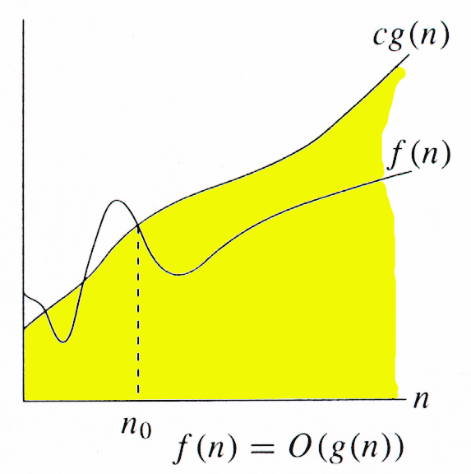
Asymptotic upper bounds
Big-oh notation
The function f(n) = O(g(n)) if and only if there exist positive constants c, n₀ such that f(n) ≤ cg(n), ∀n ≥ n₀. Big-oh can be used to denote all upper bounds on the time complexity of an algorithm. Big-oh also captures the worst case analysis of an algorithm.

Slide 51
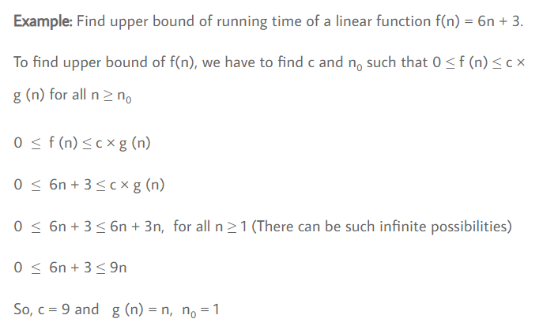

Slide 52
F(n) = 3n + 2
3n + 2 ≤ 3n + 2n, c = 5 ∀n ≥ 1 ⇒ 3n + 2 = O(n)
F(n) = 3n + 2
3n + 2 ≤ 4n, c = 4 ∀n ≥ 2 ⇒ 3n + 2 = O(n)

Slide 53
Note that 3n + 2 is O(n ²), O(n³), O(2n), O(10n) as per the definition.
i.e., it captures all upper bounds.
For the above example, O(n) is a tight upper bound whereas the rest are loose upper bounds.

Slide 54
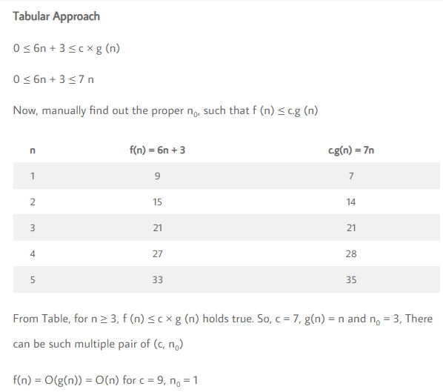

Slide 55
100n + 6 = O(n)
100n + 6 ≤ 101.n,
c = 101 ∀ n ≥ 6
T(n)=50n + 6
50n+6 <= 51n,
C=51, n₀=6

Slide 56
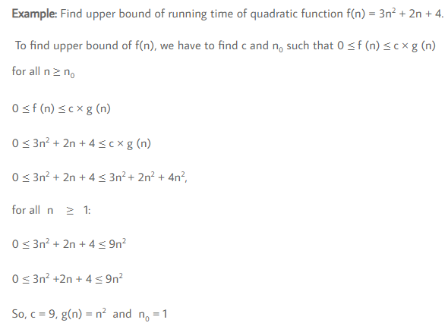

Slide 57
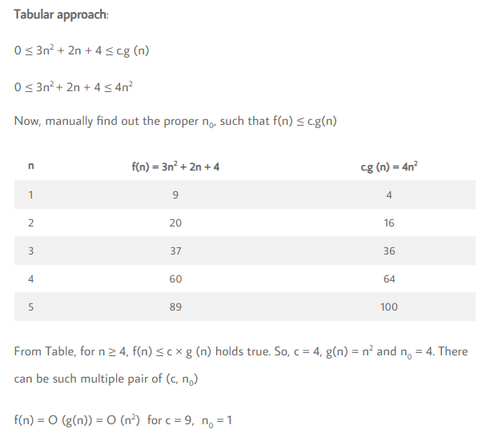


Slide 58
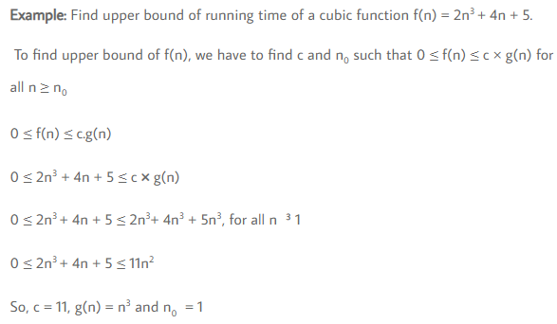

Slide 59
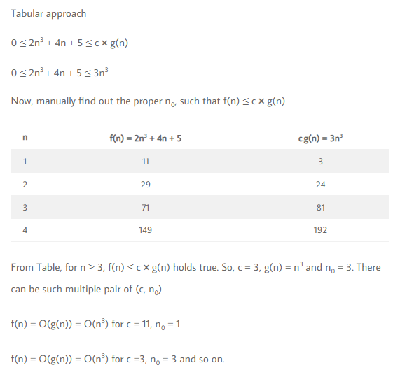

Slide 60
Big-O notation (Cont.,)
“The largest terms dominate”
The dominant term is the term that grows most quickly as n becomes large.
If you calculated that an algorithm took n² + 3n + 1 of work, the proper and correct Big-O notation is O(n²)
The O(n²) is the dominate term and the 3n + 1 part is considered negligible

Slide 61
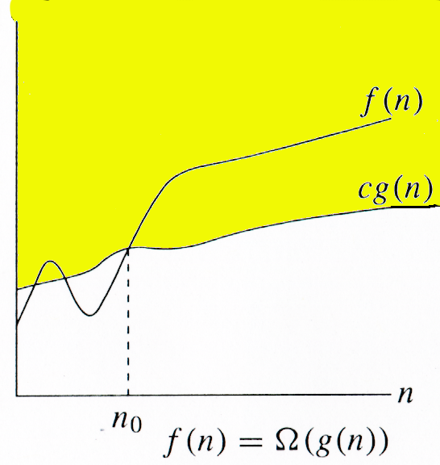
Asymptotic lower bounds
(big-Omega)
Omega notation The function f(n) = Ω(g(n)) if and only if there exist positive constants c, n₀ such that f(n) ≥ c.g(n), ∀n ≥ n₀. Omega can be used to denote all lower bounds of an algorithm. Omega notation also denotes the best case analysis of an algorithm.

Slide 62
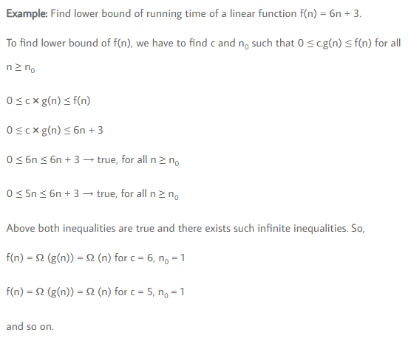

Slide 63
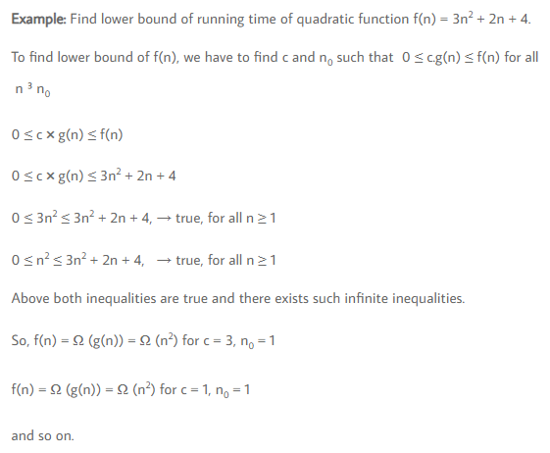

Slide 64
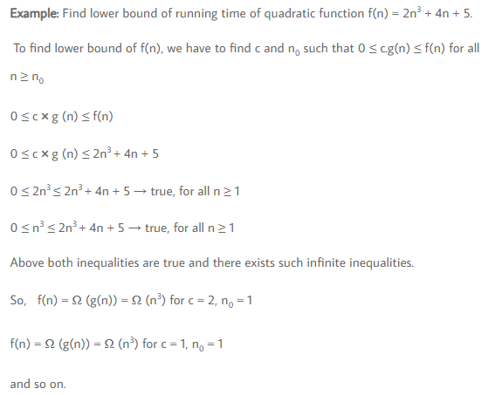

Slide 65
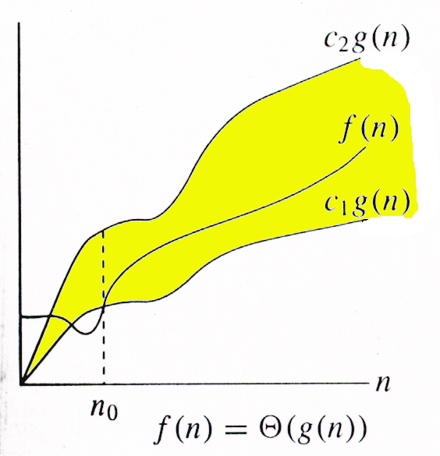
Tight Bound
(theta)
Let f(n) and g(n) are two nonnegative functions indicating running time of two algorithms. We say the function g(n) is tight bound of function f(n) if there exist some positive constants c₁, c₂, and n₀ such that 0 ≤ c₁× g(n) ≤ f(n) ≤ c₂× g(n) for all n ≥ n₀. It is denoted as f(n) = Θ (g(n)).

Slide 66
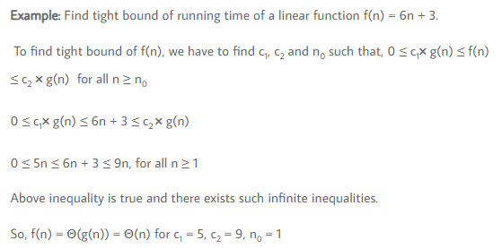

Slide 67
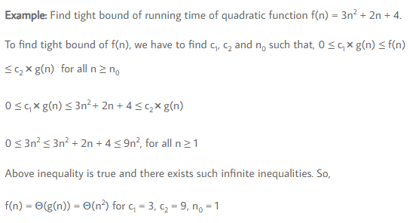

Slide 68
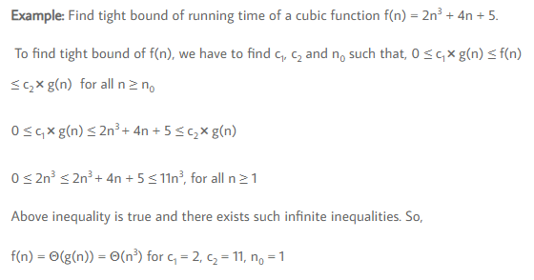

Slide 69
Examples: Big-oh
100n + 6 = O(n)
100n + 6 ≤ 101.n, c = 101 ∀n ≥ 6.
We can also write 100n + 6 = O(n³ ).
10n² + 4n + 2 = O(n² )
10n² + 4n + 2 ≤ 11.n² , c = 11 ∀n ≥ 5
6.2^{n} + n² = O(2^{n} ) 6.2^{n} + n² ≤ 7.2^{n} , c = 7 ∀n ≥ 7
3n + 3 = O(2^{n} ) 3n + 3 ≤ 10.2^{n} , c = 10 ∀n ≥ 1
n³ + n + 5 = O(n³) n³ + n + 5 ≤ 7.n³, c = 7, ∀n ≥ 1

Slide 70
Examples: Omega notation
3n + 2
3n + 2 ≥ n, ∀n ≥ 1 ⇒ 3n + 2 = Ω(n)
10n² + 4n + 2 = Ω(n² )
10n² + 4n + 2 ≥ n² , c = 1 ∀n ≥ 1
n³ + n + 5 = Ω(n³ ) n³ + n + 5 ≥ n³ , c = 1, ∀n ≥ 0
2n² + nlog n + 1 = Ω(n² ) 2n² + nlog n + 1 ≥ 2.n² , c = 2, ∀n ≥ 1
6.2^{n} + n² = Ω(2^{n} ) = Ω(n² ) = Ω(n) = Ω(1)
6.2^{n}+n² ≥ 2^{n} , c = 1 ∀n ≥ 1

Slide 71
3n + 10¹⁰
3n ≤ 3n + 10¹⁰ ≤ 4n, ∀n ≥ 10¹⁰
⇒ 3n + 10¹⁰ = Θ(n)
10n² + 4n + 2 = Θ(n² )
10n² ≤ 10n² + 4n + 2 ≤ 20n², ∀n ≥ 1,c₁ = 10,c₂=20
6(2^{n}) + n² = Θ(2^{n})
6(2^{n}) ≤ 6(2^{n}) + n² ≤ 12(2^{n}), ∀n ≥ 1, c₁ = 6, c₂ = 12

Slide 72
2n² + n log n + 1 = Θ(n² )
2n² ≤ 2n² + n log₂n + 1 ≤ 5.n² ,∀n ≥ 2, c₁ = 2, c₂=5
n√n + n log₂ (n) + 2 = Θ(n √ n)
n√n ≤ n√ n + n log₂ (n) + 2 ≤ 5.n√n, ∀n ≥ 2, c₁ = 1, c₂ = 5

Slide 73
Time Complexities
Best Case
Measure the minimum time that the algorithm will require for an input of size n.
Worst Case
Measure the maximum time that the algorithm will require for an input of size n.
Average Case
Averaging the running time of an algorithm for all possible input of size n.

Slide 74
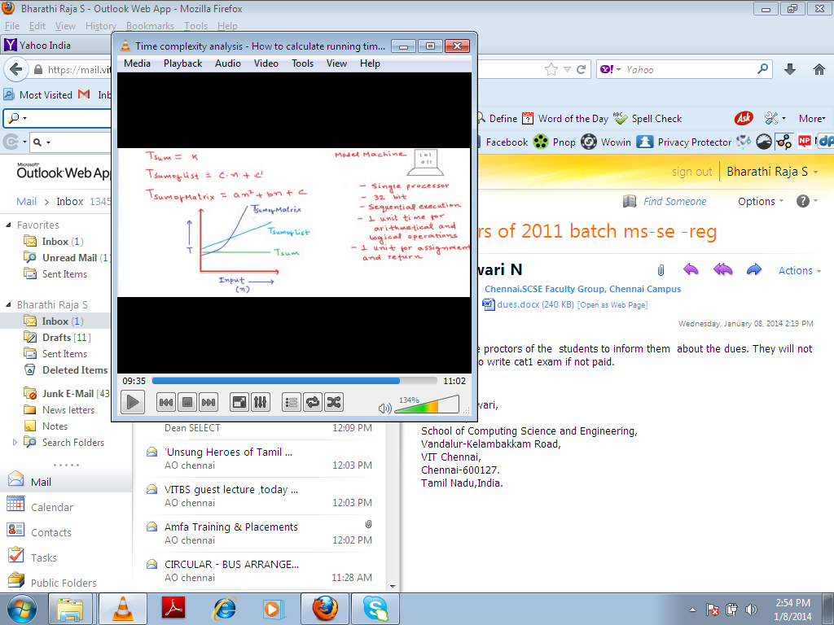

Slide 75
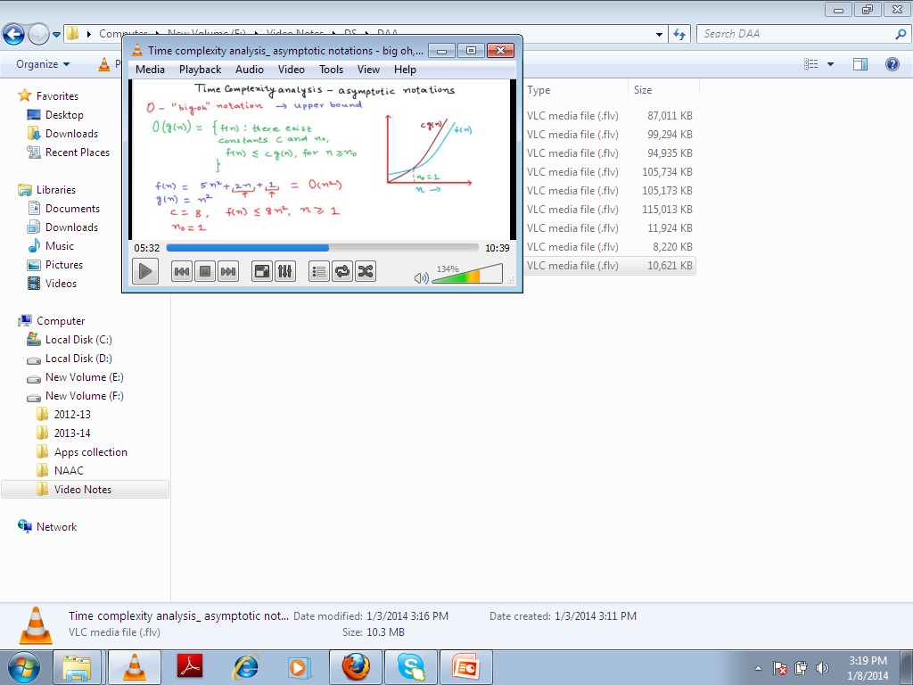

Slide 76
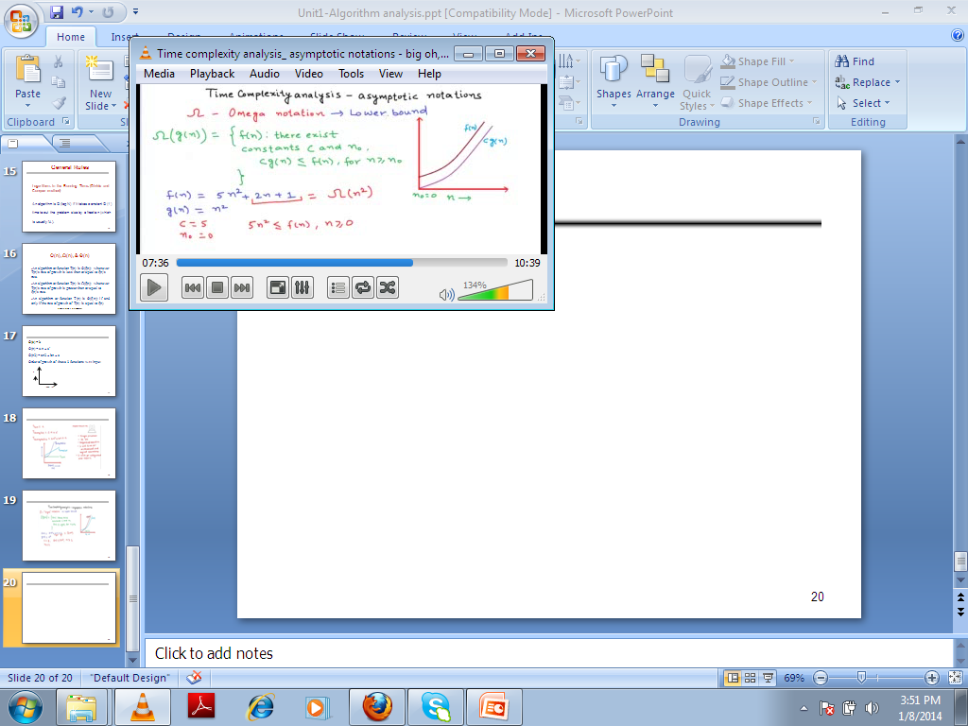

Slide 77
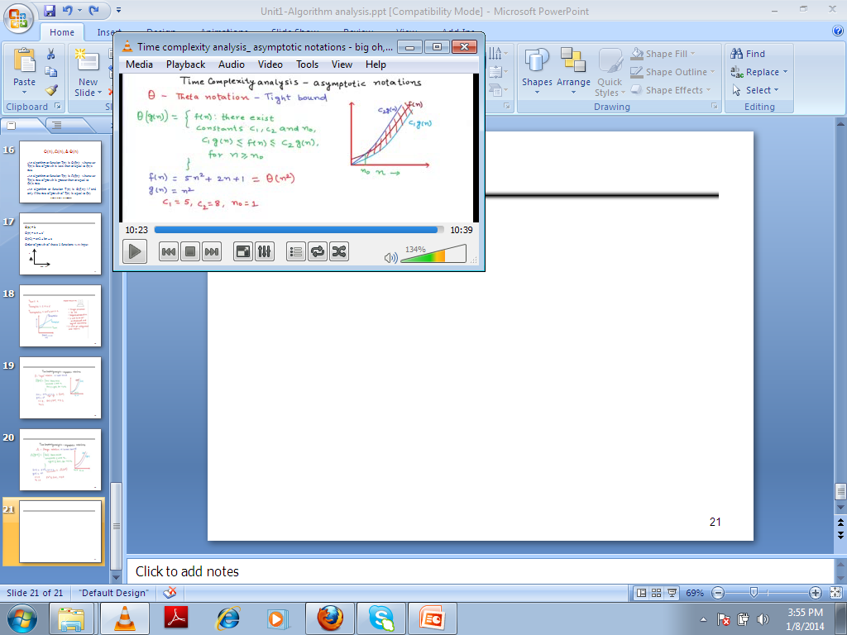

Slide 78
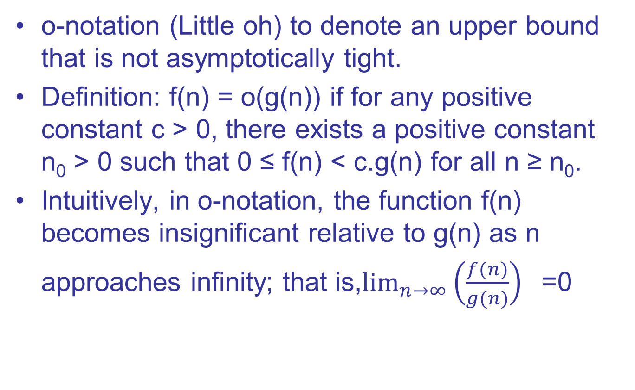
o-notation

Slide 79
For example,
2n = o(n²), but 2n² != o(n²).
here n² is polynomially larger than 2n by n^{ϵ}, ϵ =1.
100n+6 = o(n^{1.2}), here n^{1.2} is polynomially larger than 100n+6 by n^{ϵ}, ϵ = 0.2.
for any positive constant c, there exist n₀ such that ∀n ≥ n₀, 100n + 6 ≤ c.n^{1.2}
10n² + 4n + 2 = o(n³) Here n³ is polynomially larger than 10n² + 4n + 2 by n^{ϵ}, ϵ =1.

Slide 80
6.2^{n} + n² = o(3^{n})
For any c > 0, 2^{n} ≤ c.3^{n}.
3n + 3 = o(n^{1.00001}) Here n^{1.00001} is polynomially larger than 3n + 3 by n^{ϵ}, ϵ = 0.00001
n³ + n + 5 = o(n^{3.1}) Here n^{3.1} is polynomially larger than n³ + n + 5 by n^{ϵ}, ϵ = 0.1

Slide 81
ω-notation
We use ω-notation to denote a lower bound that is not asymptotically tight.
Definition: ω(g(n)) (little-omega) as f(n) = ω(g(n)) if for any positive constant c > 0, there exists a positive constant n₀ > 0 such that 0 ≤ c.g(n) < f(n) for all n ≥ n₀.
Example,
n² = ω(n) but n² != ω(n²)
3n + 2 = ω(log(n))
10n³ + 4n + 2 = ω(n²)

Slide 82
5n⁶ + 7n + 9 = ω(n³)
2n² + n log n + 1 = ω(n^{1.9999999})
15 × 3^{n} + n² = ω(2^{n}) = ω(n²) = ω(n) = ω(1)

